Slide 1
Diagnostic Accuracy of Fractional Flow Reserve from Anatomic Computed TOmographic Angiography: The DeFACTO Study
James K. Min¹; Jonathon Leipsic²; Michael J. Pencina³; Daniel S. Berman¹; Bon-Kwon Koo⁴; Carlos van Mieghem⁵; Andrejs Erglis⁶; Fay Y. Lin⁷; Allison M. Dunning⁷; Patricia Apruzzese³; Matthew J. Budoff⁸; Jason H. Cole⁹; Farouc A. Jaffer¹⁰; Martin B. Leon¹¹; Jennifer Malpeso⁸; G.B. John Mancini¹²; Seung-Jung Park¹³, Robert S. Schwartz¹⁴; Leslee J. Shaw¹⁵, Laura Mauri¹⁶ on behalf of the DeFACTO Investigators
¹Cedars-Sinai Heart Institute, Los Angeles, CA; ²St. Paul’s Hospital, Vancouver, British Columbia; ³Harvard Clinical Research Institute, Boston, MA; ⁴Seoul National University Hospital, Seoul, Korea; ⁵Erasmus Medical Center, Rotterdam, Netherlands; ⁶Pauls Stradins Clinical University Hospital, Riga, Latvia; ⁷Weill Cornell Medical College, New York, NY; ⁸Harbor UCLA Medical Center, Los Angeles, CA; ⁹Cardiology Associates, Mobile, AL; ¹⁰Massachusetts General Hospital, Harvard Medical School, Boston, MA; ¹¹Columbia University Medical Center, New York, NY; ¹²Vancouver General Hospital, Vancouver, British Columbia; ¹³Asan Medical Center, Seoul, Korea; ¹⁴Minneapolis Heart Institute, Minneapolis, MN; ¹⁵Emory University School of Medicine, Atlanta, GA; ¹⁶DBrigham and Women’s Hospital, Boston, MA

Slide 2
Disclosures
Research Support: NHLBI (R01HL115150-01; U01 HL105907-02 [Contract]); QNRF (NPRP 09-370-3-089); GE Healthcare (significant); Philips Healthcare (modest); Vital Images (modest)
Equity Interest: TC3, MDDX, Cedars-Sinai Medical Center
Medical Advisory Board: GE Healthcare, Arineta
Study Funding: This study was funded by HeartFlow, Inc. HeartFlow, Inc. worked with the steering committee for study design and provided blinded FFR_{CT} analyses for the study. HeartFlow, Inc. did not have involvement in the statistical data analysis, manuscript preparation, and review or authorization for submission.
No study investigator had any financial interest related to the study sponsor

Slide 3
Background
Coronary CT angiography is a non-invasive test that demonstrates high accuracy to invasive angiography but cannot determine the hemodynamic significance of a coronary lesion¹
Fractional flow reserve (FFR) is the gold standard for diagnosis of lesion-specific ischemia², and its use to guide coronary revascularization improves event-free survival and lowers healthcare costs^{3,4}
Computational fluid dynamics is a novel technology that enables calculation of FFR from CT (FFR_{CT}), and may represent a non-invasive method for determination of lesion-specific ischemia⁵
To date, the diagnostic performance of FFR_{CT} has not been tested in a large-scale prospective multicenter study
¹Min et al. J Am Coll Cardiol 2010; 55: 957-65; ²Piljs et al. Cath Cardiovasc Interv 2000; 49: 1-16; ³Tonino et al. N Engl J Med 2009; 360: 213-24; ⁴Berger et al. J Am Coll Cardiol 2005; 46: 438-42; ⁵Kim et al. Ann Biomed Eng 2010; 38: 3195-209; ⁶Erglis et al. ESC 2010 Scientific Sessions; Abstract 951

Slide 4
Objective
The OVERALL OBJECTIVE of the DeFACTO study was to determine the diagnostic performance of FFR_{CT} for the detection and exclusion of hemodynamically significant CAD in a prospective multicenter international study.
Notes:
To determine the clinical and cost effectiveness of a “selective catheterization” strategy versus a “direct catheterization” strategy for stable patients with suspected but without known CAD and clinical indication for non-emergent ICA.

Slide 5
Study Endpoints
Primary: Per-patient diagnostic accuracy of FFR_{CT} plus CT to determine the presence or absence of at least one hemodynamically significant coronary stenosis, as compared to an invasive FFR reference standard*
Study hypotheses tested at one-sided 0.05 Type I error rate, with null hypothesis to be rejected if lower bound of 95% CI > 0.70
0.70 threshold chosen b/c this represented the mid-point of test accuracy for stress imaging testing¹, 3-fold higher accuracy than recent large-scale reports of “real world” testing², and higher than the point of concordance of stress imaging testing with invasive FFR
Assuming 0.35 rate of CAD, 238 patients (assuming 11% rate of nonevaluable CTs³) needed to achieve 95% statistical power
Secondary:
Additional diagnostic performance characteristics (e.g., sensitivity / specificity)
Diagnostic performance for lesions of intermediate stenosis severity
Per-vessel correlation of FFR_{CT} value to FFR measured value
¹Mowatt et al. Health Technol Assess 2004; 30: 1-207; ²Madder RD et al. J Cardiovasc Comput Tomogr 2011; 5: 165-71; ³Budoff MJ et al. J Am Coll Cardiol 2008; 52: 1724-32; ³Melikian N et al. JACC Cardiovasc Interv 2010; 3: 307-14
Notes:
To determine the clinical and cost effectiveness of a “selective catheterization” strategy versus a “direct catheterization” strategy for stable patients with suspected but without known CAD and clinical indication for non-emergent ICA.

Slide 6
Inclusion / Exclusion Criteria
Inclusion Criteria:
Age > 18 years
Providing written informed consent
Scheduled to undergo clinically-indicated non-emergent ICA
>64-row CT within 60 days prior to ICA
No cardiac interventional therapy between CT and ICA
Exclusion Criteria (Cardiac-specific):
Prior coronary artery bypass surgery
Prior PCI with suspected in-stent restenosis
Suspicion of acute coronary syndrome
Prior myocardial infarction within 40 days of ICA
Notes:
To determine the clinical and cost effectiveness of a “selective catheterization” strategy versus a “direct catheterization” strategy for stable patients with suspected but without known CAD and clinical indication for non-emergent ICA.

Slide 7
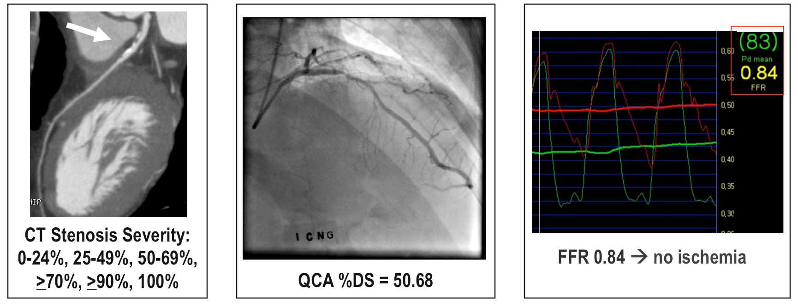
Study Procedures
All studies (CT, QCA, FFR, FFR_{CT}) interpreted in blinded fashion by 4 independent core labs.
CT: Image acquisition / interpretation in accordance with societal guidelines on >64-row CT
QCA: % diameter stenosis determined in standard fashion using commercially available software
FFR: Standard fashion by commercially available equipment after administration of nitroglycerin and intravenous adenosine at rate of 140 mcg/kg/min through a central vein
FFR = (mean distal coronary pressure) / (mean aortic pressure ) during hyperemia
Definitions: Anatomic obstructive CAD defined as >50% diameter stenosis for CT and QCA; Lesion-specific ischemia defined as <0.80 for both FFR and FFR_{CT}¹
FFR: Per protocol, subtotal (99%) or total (100%) occlusions assigned value of 0.50
FFR_{CT}: Per protocol, subtotal / total occlusions assigned value of 0.50, and vessels with <30% maximal stenosis assigned value of 0.90
¹Tonino PA et al. N Engl J Med 2009; 360: 213-24
Notes:
CT: Defined as obstructive CAD >50% diameter stenosis
ICA: Defined as obstructive CAD >50% diameter stenosis
FFR: Defined for lesion-specific ischemia as <0.80
In keeping with prior multicenter trials, subtotal (99%) or total (100%) occlusions assigned a value of 0.50
FFR_{CT}: Defined for lesion-specific ischemia FFR_{CT} <0.80
Per study protocol, vessels with subtotal (99%)/ total (100%) occlusions assigned value of 0.50, and vessels with <30% maximal stenosis assigned value of 0.90

Slide 8
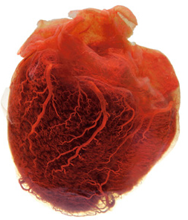
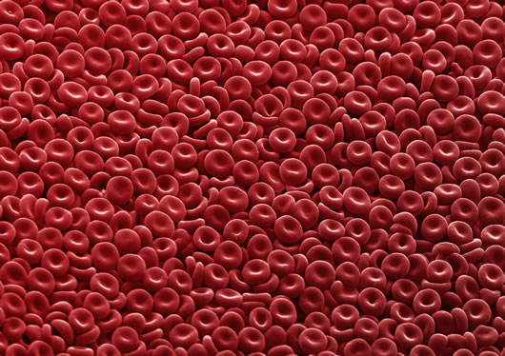
Computation of FFR_{CT}
FFR_{CT} performed by HeartFlow scientists in blinded fashion.
(1)
(2)
(3)
(4)
(5)
(6)
Image-based Modeling – Comprehensive segmentation of coronary arteries and aorta to determine patient-specific coronary geometry
Heart-Vessel Interactions – At aortic and coronary outlets, enforced relationships b/w pressure and flow (e.g., aortic impedence)
Segmentation of Left Ventricular Myocardial Mass – Relate time-varying coronary resistance (i.e., pulsatile) to intramyocardial pressure
Calculation of microcirculatory resistance – Use of allometric scaling laws to relate patient-specific “form –function relationships (e.g. mass / size of object related to physiology)
Patient-specific Physiologic Conditions - Fluid viscocity (hematocrit), blood pressure
Modeling of Hyperemia – Standard prediction model to “virtually” force complete smooth muscle cell relaxation (arteriolar vasodilatation)
Calculation of Fluid Dynamic Phenomena – Application of universality of fluid dynamics, based upon Conservation of mass and momentum balance (e.g., airflow over jet; water flow in a river, etc.)
Notes:
To determine the clinical and cost effectiveness of a “selective catheterization” strategy versus a “direct catheterization” strategy for stable patients with suspected but without known CAD and clinical indication for non-emergent ICA.

Slide 9
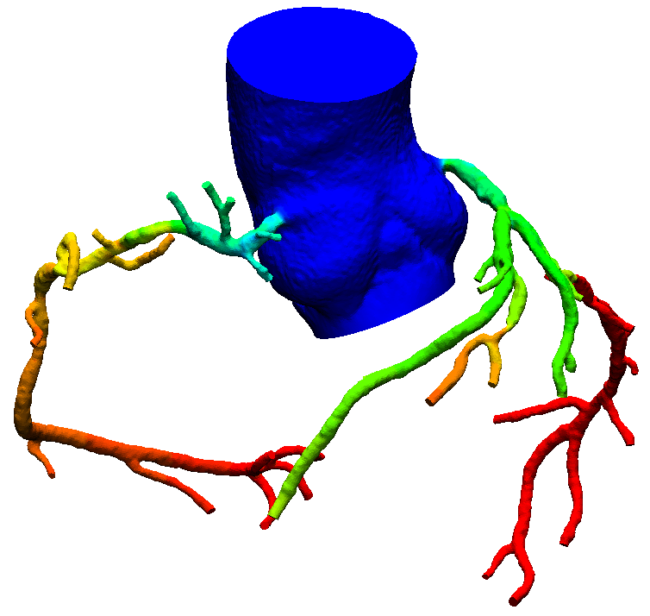
Computation of FFR_{CT}
Patient-Specific Hyperemic Flow and Pressure:
Numerical method using governing equations
Obtain solution for velocity and pressure throughout coronary vascular bed
Simultaneous solution of millions of non-linear partial differential equations
Repeat process thousands of time intervals within cardiac cycle
3D FFR_{CT} Computed Map
FFR_{CT} does not require:
Modification to imaging protocols (i.e., prospective /retrospective ECG gating; fast pitch helical; FBP or IR)
Administration of adenosine
Additional image acquisition (i.e., no additional radiation)
Single-point assessment (i.e., FFR_{CT} selectable on any point in coronary vascular bed)
FFR_{CT} derived from a typically acquired CT
FFR_{CT} = 0.72
(can select any point on model)
Notes:
To determine the clinical and cost effectiveness of a “selective catheterization” strategy versus a “direct catheterization” strategy for stable patients with suspected but without known CAD and clinical indication for non-emergent ICA.

Slide 10
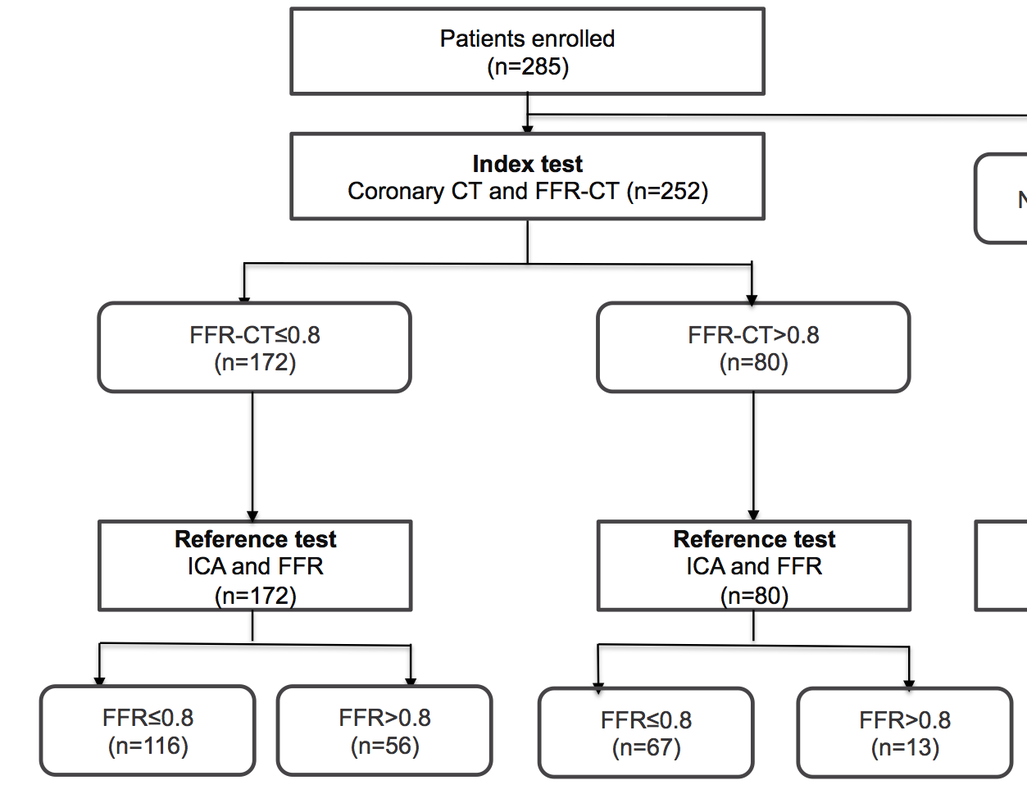
Patient Enrollment
Enrollment occurred between October 2010 – October 2011 at 17 centers in 5 countries [Belgium (1), Canada (1), Latvia (1), South Korea (2), United States (12)]
33 patients excluded due to non-evaluable CTs as determined by the CT Core Laboratory (n=31), and inability to integrate CT / FFR wire placement as determined by the Integration Core Laboratory (n=20

Slide 11
Study Characteristics
Variable | Mean + SD or N (%)
Age (years) | 62.9±8.7
Prior MI | 15 (6.0)
Prior PCI | 16 (6.3)
Symptoms Stable Worsening Other (e.g., silent ischemia) | 201 (79.7) 43 (17.2) 8 (3.1)
Male gender | 178 (70.6)
Race / Ethnicity White Asian Other | 169 (67.1) 78 (31.0) 5 (2.0)
Diabetes mellitus | 53 (21.2)
Hypertension | 179 (71.2)
Hyperlipidemia | 201 (79.8)
FH of CAD | 50 (19.9)
Current smoker | 44 (17.5)
n=90
n=223
n=95
Variable | Mean + SD or N (%)
Invasive Test Characteristics*
Stenosis >50% | 190 (46.5)
Average stenosis (%) | 46.8±15.7
FFR <0.80 | 151 (37.1)
Non-invasive Test^
Stenosis >50% | 216 (53.2)
>90% Stenosis | 79 (19.5)
Coronary Calcium (Agatston units) | 381.5 ± 401.0
*N=408 vessels from 252 patients; ^N=406 vessels from 252 patients

Slide 12
Per-Patient Diagnostic Performance
FFRCT
CT
95% CI
FFRCT
CT
95% CI
67-78
58-70
95% CI
84-95
77-90
95% CI
46-83
34-51
95% CI
60-74
53-67
95% CI
74-90
61-81

Slide 13
Discrimination
Per-Patient
Per-Vessel
FFR_{CT} 0.81 (95% CI 0.75, 0.86)
CT 0.68 (95% CI 0.62, 0.74)
FFR_{CT} 0.81 (95% CI 0.76, 0.85)
CT 0.75 (95% CI 0.71, 0.80)
Greater discriminatory power for FFR_{CT} compared to CT stenosis on per-patient (Δ = 0.13) and per-vessel basis (Δ = 0.06)

Slide 14
Per-Patient Diagnostic Performance for Intermediate Stenoses by CT (30-70%)
FFRCT
CT
95% CI
FFRCT
CT
95% CI
61-80
63-92
95% CI
63-92
53-77
95% CI
53-77
53-77
95% CI
39-68
20-53
95% CI
75-95
55-79

Slide 15
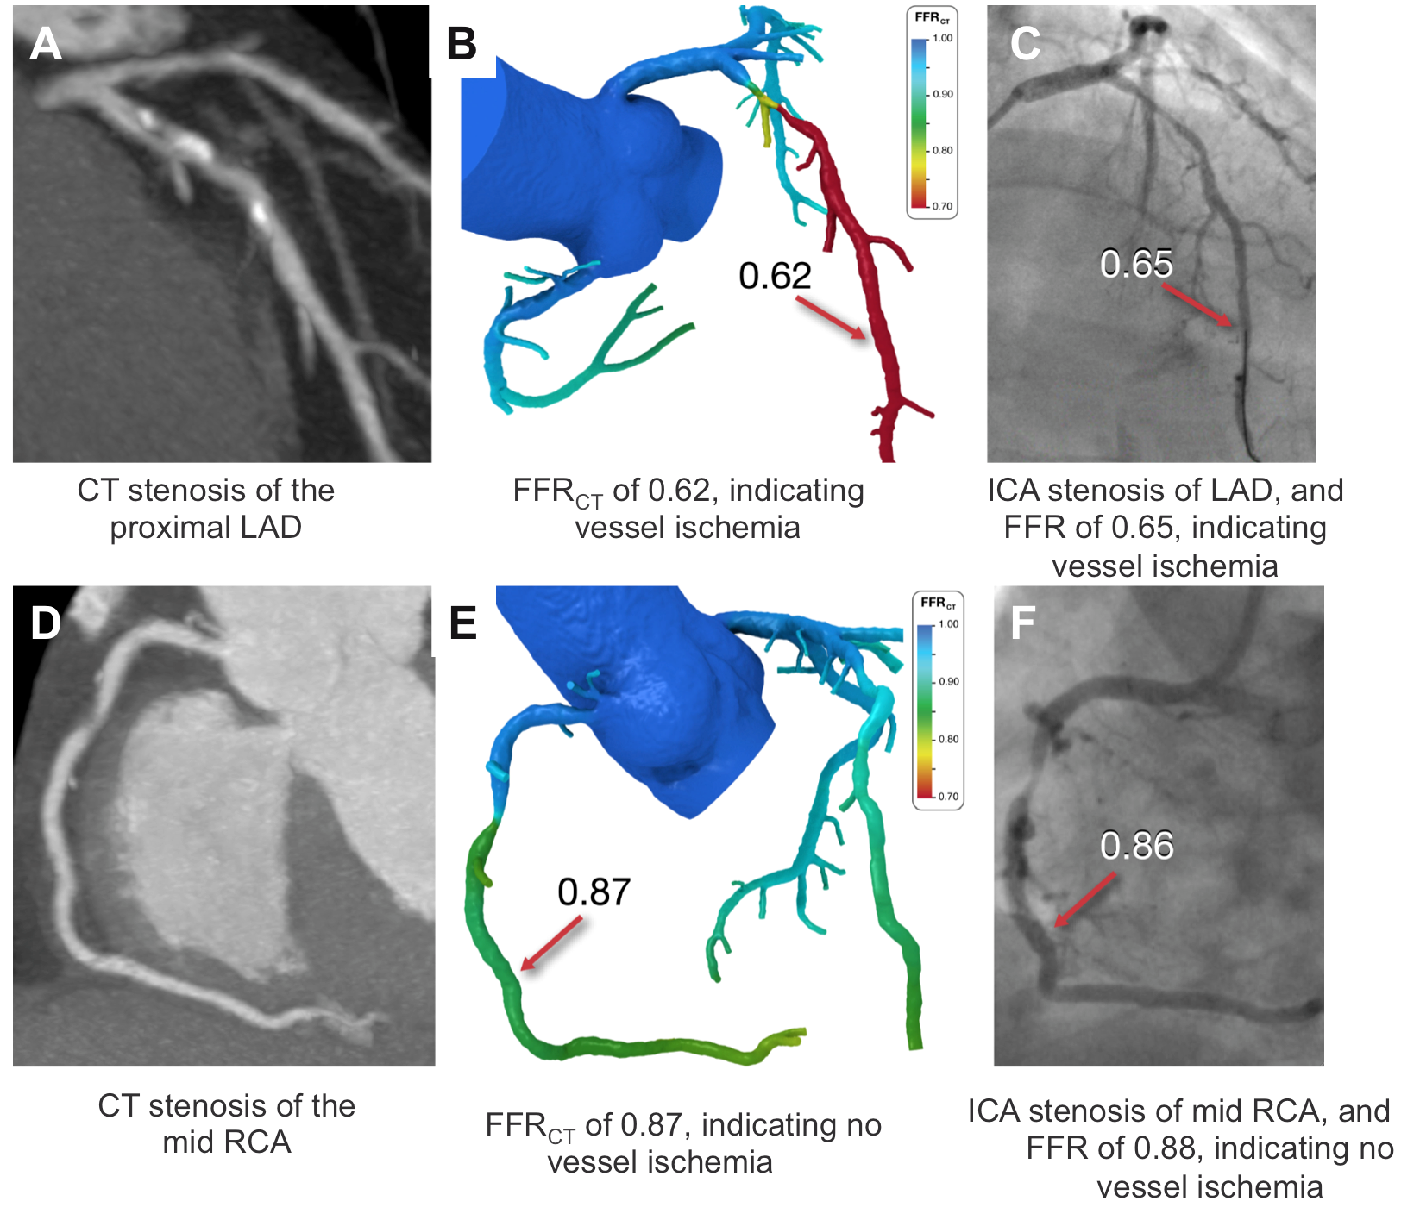
Case Examples

Slide 16
Limitations
Enrollment criteria disqualified individuals with prior CABG or suspected in-stent restenosis after PCI
Not every vessel was interrogated in study participants
Only vessels deemed clinically-indicated for evaluation
Unknown whether revascularization of ischemic lesions by FFR_{CT} reduces ischemia
FFR_{CT} algorithms enable calculation after “virtual” revascularization¹
Study did not exclusively enroll patients considered anatomically indeterminate by CT (30-70%)^{2,3}
FFR_{CT} compared favorably to CT stenosis in subset
¹Koo BK et al. 2012 EuroPCR Scientific Sessions, ²Fearon et al. Am J Cardiol 2000: 86: 1013-4; ²Melikian N et al. JACC Cardiovasc Interv 2010; 3: 307-14

Slide 17
Conclusions
In stable patients with suspected CAD, FFR_{CT} demonstrated improved diagnostic accuracy over CT stenosis for diagnosis of both patients and vessels who manifest ischemia
Did not satisfy its pre-specified primary endpoint of Dx accuracy >70% of lower bound of the one-sided 95% CI
High sensitivity and NPV implies low rate of FN
Considerable increase in discriminatory power
In patients with stenoses of intermediate severity by CT—which are the most clinically ambiguous for ischemia determination—FFR_{CT} demonstrated higher diagnostic performance compared to CT alone
Proof of feasibility of FFR_{CT,} and represent first large-scale prospective demonstration of use of computational models to accurately calculate FFR from typically acquired CT images

Slide 18
Thank you.

